Slide 1
Asymmetric Encryption and Hashing
Cybersecurity
Lesson 11.2

Slide 2

Learning Objectives
By the end of today’s lesson, you will be able to:
1
Calculate the required number of symmetric and asymmetric keys based on
the number of people exchanging secure messages.
2
Use GPG to generate keys and encrypt and decrypt private messages.
3
Use hashes to validate the integrity of data.
4
Use digital signatures to validate the authenticity of data.

Slide 4

Cryptography Review

Slide 5
Cryptography Review
01
Cryptography
06
Encoding
02
Ciphers
07
PAIN
03
Encryption/Decryption
08
Security trade-off
04
Key
09
Symmetric key algorithms
05
Block and stream ciphers
10
OpenSSL

Slide 7
Cryptography refresher
You will continue to act as a security analyst working for the Hill Valley Police Department.
In this review activity, you must encrypt and decrypt a message
using OpenSSL.
20 minutes

Slide 10

Key Management and Exchange

Slide 11


Key Management and Exchange
In the previous activity, we used symmetric key encryption.
While its benefits include speed, efficiency, and simplicity of use,
symmetric encryption also has disadvantages.
Symmetric Encryption
Shared Key
010011010010010101000100010010101010100101010101010101001010
Encrypt
Decrypt
Message
Ciphertext
Message

Slide 12
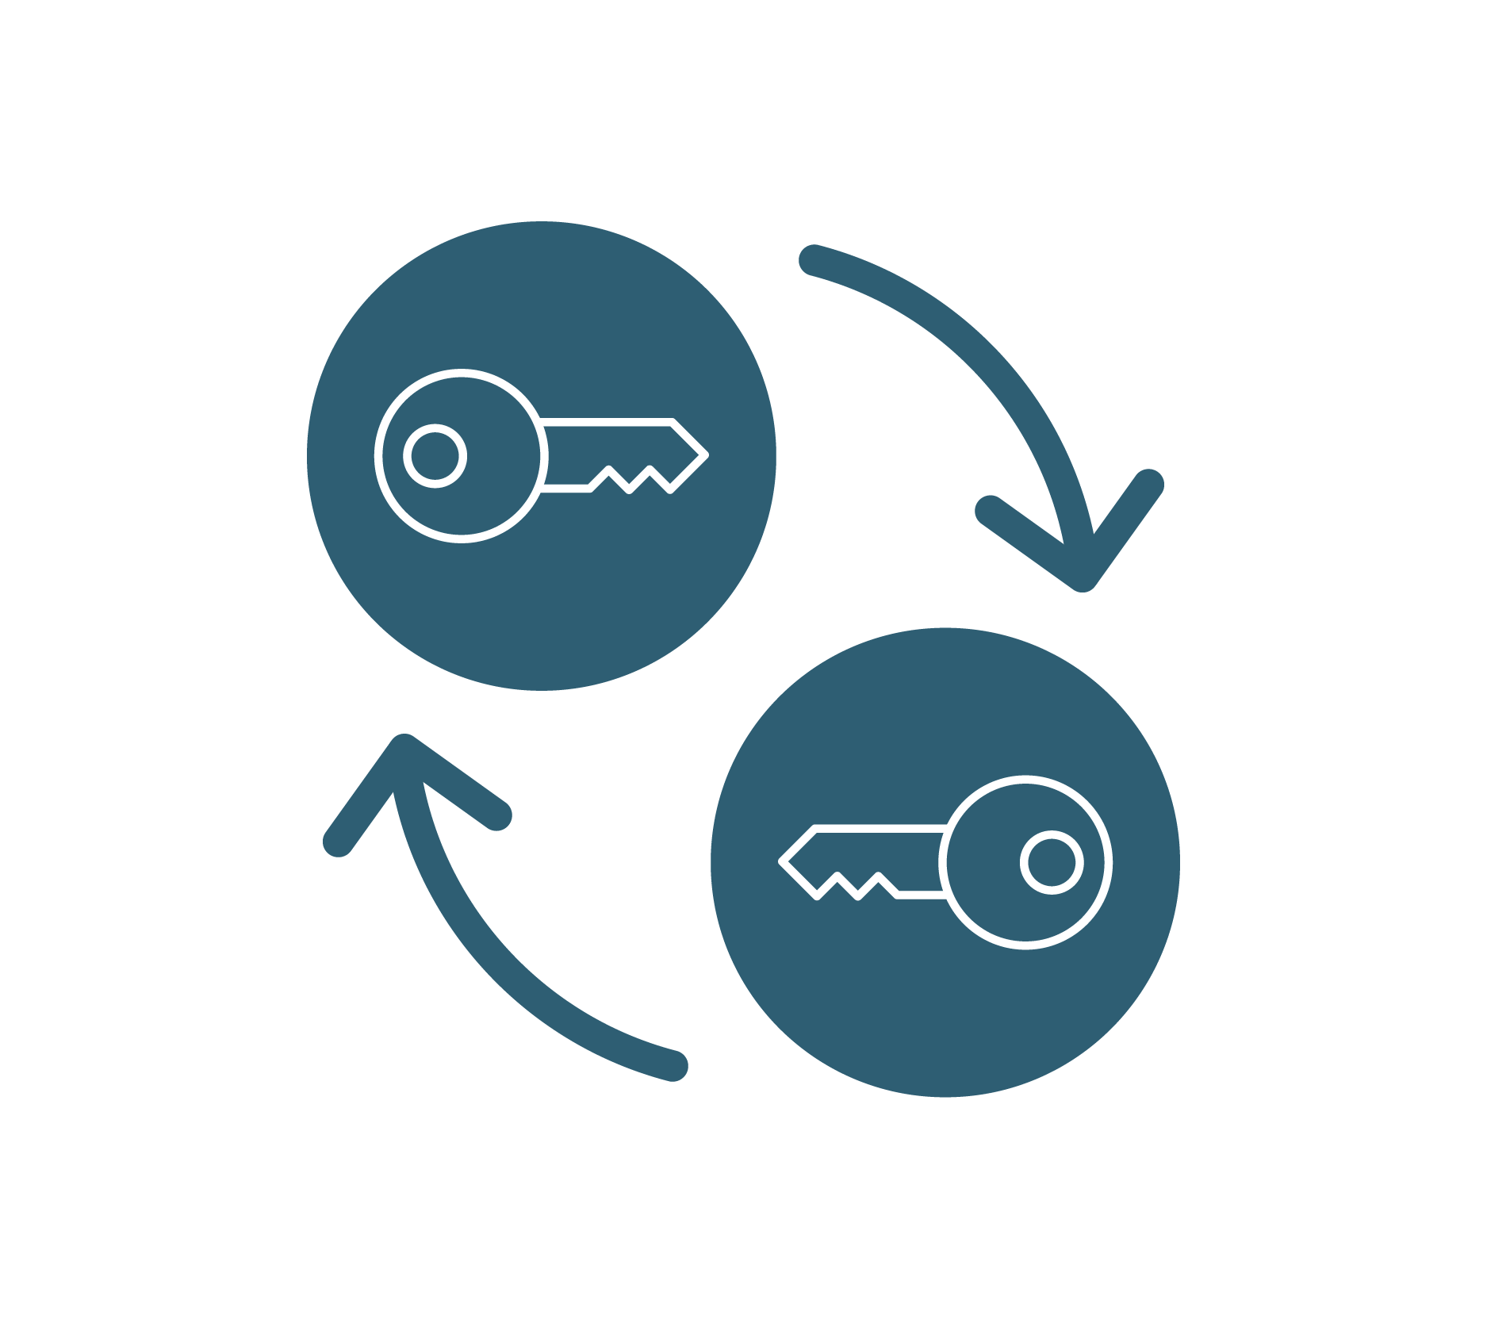
Key Management and Exchange
Disadvantage 1: Secure key exchange
Offline Exchange (Out-of-Band Exchange)
Can include mailing the key, or calling
the other party and reading the key.
Intercepted mail
Tapped phone line
Diffie-Hellman Key Exchange
Uses mathematics to create
a shared secret between two
parties over a public channel.

Slide 13






Key Management and Exchange
Disadvantage 2: Key management
Julie
Tim
Key 2
Key 1
Key 6
Key 4
Key 3
Alice
Bob
Key 5
Symmetric key cryptography between two parties only requires managing one key. But there needs to be a key for each combination of individuals.

Slide 14


Key Management and Exchange
Count of symmetric keys = (N * (N-1))/ 2
For an organization with 7 employees
For an organization with 1,000 employees
For an organization with 7 employees:
For an organization with 1,000 employees:
(7 * 6) / 2 = 42 / 2 = 21
(1,000 * 999) / 2 = 499,500‬

Slide 15

Asymmetric/Public Key Cryptography

Slide 16
Symmetric key disadvantages can be addressed with asymmetric key encryption.

Slide 17

Asymmetric Key Encryption
Each individual possesses a two-key pair:
Private keys are kept secret and can affect the confidentiality of messages if exposed.
Private Key
Public keys are public and accessible to all.
Public Key
Like symmetric keys, these public and private
keys are typically a random alphanumeric string.

Slide 18

Asymmetric Key Encryption
Scenario: Tim wants to send Julie his bank account number using asymmetric key encryption.
Private Key
Julie will have
a public and
a private key.
The public key
Is truly public, accessible on
Julie’s website.
Public Key

Slide 19


Asymmetric Key Encryption
Scenario: Tim wants to send Julie his bank account number using asymmetric key encryption.
LXFOPVEFRNHR#4&/j2
Public Key
Tim creates a plaintext message containing his bank account number.
Tim goes to Julie’s website, obtains her
public key, and uses it
to encrypt his message.

Slide 20

Asymmetric Key Encryption
Scenario: Tim wants to send Julie his bank account number using asymmetric key encryption.
LXFOPVEFRNHR#4&/j2
Public Key
Tim sends
the encrypted
message to Julie.
This can be sent over email or Slack without fear of interception.
The message can only
be decrypted by Julie with her matching private key.

Slide 21

Asymmetric Key Encryption
Scenario: Tim wants to send Julie his bank account number using asymmetric key encryption.
LXFOPVEFRNHR#4&/j2
Bank
Account
#
Private Key
Julie receives Tim’s encrypted message and decrypts it using her matching private key.
Julie can now access Tim’s
bank account number.

Slide 22
Key pairs always have to be used together.
If a public key is used to encrypt a message, its matching private key will be used to decrypt the message.

Slide 23
Asymmetric Key Encryption
If Tim and Julie each needed to send messages to each other,
four keys would be required for secure communication.
Private Key
Private Key
Public Key
Public Key

Slide 24

Key Management
While symmetric key count grows exponentially larger as the number of employees increases, the asymmetric count stays proportionate and manageable.
For a company with 12 employees:
Symmetric
(N * (N-1)) / 2
(12 * 11) / 2 = 66
Asymmetric
N * 2
(12 * 2) = 24

Slide 25
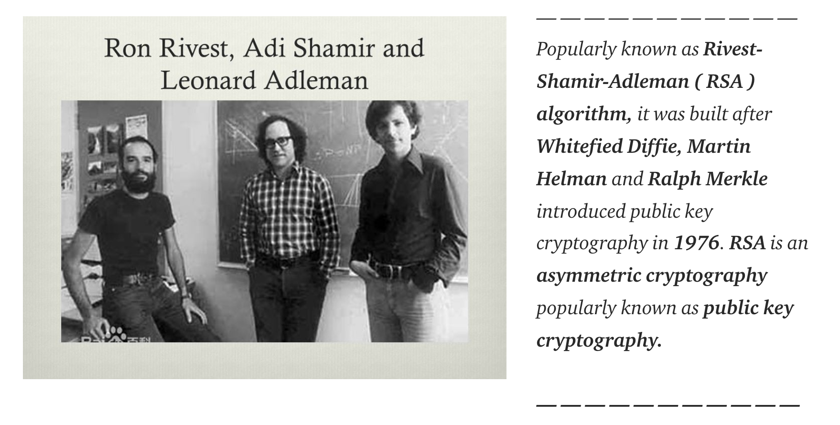
RSA
Asymmetric encryption uses an algorithm called RSA, which was
introduced in 1977 and named after the surnames of its creators.

Slide 26
RSA is an asymmetric algorithm that is still a worldwide standard today.
It works by employing the complexity of factoring large numbers.

Slide 27
Asymmetric Key Summary
Asymmetric encryption uses two keys: One public and one private
Public keys are accessible by anyone
Private keys are only accessible by their owner
Public and private keys have to work together
Asymmetric encryption addresses the challenges of symmetric encryption
The standard asymmetric algorithm used today is RSA

Slide 29

Applying Public Key
Cryptography with GPG

Slide 30

GNU Privacy Guard (GPG)
GPG is:
Command Line Tool
Create keys
Encryption
Decryption
Free Program
Multiple distros
Symmetric algorithms
Asymmetric algorithms

Slide 31

Demonstration Scenario
We will demonstrate how to create a key pair and do asymmetric encryption and decryption with GPG.
Asymmetric Encryption
Public Key
Private Key
010011010010010101000100010010101010100101010101010101001010
Decrypt
Encrypt
Decrypt
Message
Ciphertext
Message
Notes:
shutterstock_1888488028

Slide 32
GPG

Slide 33
GPG
You will continue to play the role of a security analyst working for the
Hill Valley Police Department.
Captain Strickland has implemented your suggestion of using asymmetric key encryption across all departments at Hill Valley.
You will use asymmetric encryption with GPG to encrypt and decrypt text files.
20 minutes

Slide 37
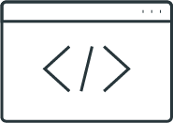
Hashing and Data Integrity

Slide 38

Always Remember the CIA!
So far, we’ve used cryptography to protect privacy and confidentiality.
It can also be applied to protect the integrity of data.
1
Confidentiality
INFORMATION
SECURITY
2
3
Integrity
Availability
Notes:
Image source: shutterstock_708213337 (shield)

Slide 39
Hashing is a cryptographic method used to verify
the integrity of data.

Slide 40
Hashing
Similar to encryption, hashing uses mathematical algorithms called hashing algorithms to take data and generate a unique output.
I Love Cryptography!
676e4bff90a76853bda00773f7ad4bed
MD5

Slide 41

Difference 1: Keys vs. No Keys
Encryption takes plaintext and converts it to ciphertext with a key and an algorithm.
LXFOPVEFRNHR#4&/j2
Encryption Key
Decryption Key
Plaintext
Encrypted Text
Plaintext
Hashing takes plaintext and converts it to a message digest with an algorithm and no key.
LXFOPVEFRNHR#4&/j2
Plaintext
Hash Function
Hashed Text

Slide 42

Difference 1: Keys vs. No Keys
Message digests are also known as fingerprints, hashes, and checksums.
They are unique identifiers of the plaintext that is outputted from the algorithm.
For example:
676e4bff90a76853bda00773f7ad4bed

Slide 43

Difference 2: Reversible vs. Irreversible
Encryption converts ciphertext and plaintext back and forth using encryption and decryption.
“I Love Cryptography!”
676e4bff90a76853bda00773f7ad4bed
Plaintext
Hash Function
Hashed Text
Hashing is a one-way function, meaning it
cannot be converted back to plaintext.

Slide 44
Difference 3: Output Lengths
Hashing algorithms output fixed lengths. Regardless of the input length, the output length is always the same.
I Love Cryptography!
#
676e4bff90a76853bda00773f7ad4bed
Hi
#
c1a5298f939e87e8f962a5edfc206918
#
We hold these truths to be self-evident, that all men are created equal, that they are endowed by their Creator with certain unalienable Rights, that among these are Life, Liberty, and the pursuit of Happiness…
124650d689d47f777f715a25260a29c2
This is the hash of the entire U.S. Declaration of Independence!

Slide 45

Difference 4: Goals
Encryption’s main goal is privacy.
Hashing’s main goal is integrity.

Slide 46
Difference 4: Goals
If a small change is made to the sentence, the same hashing algorithm would produce a completely different message digest.
I Love Cryptography!
#
676e4bff90a76853bda00773f7ad4bed
I Love Cryptography!!
#
4e6fc433ff57a6c4a854cbbeff65f61a

Slide 47
Hashing Algorithms
Hashing has several algorithms:
SHA | Stands for secure hash algorithms and includes its successors SHA1 and SHA2.
SHA2 | Has variations with different security strengths: SHA-256 and SHA-512.
MD | Stands for message digest and has several variations: MD2, MD4, and MD5.
LM and NTLM | Are hashes used by Windows.

Slide 48
Demonstration Scenario
There are command-line tools that easily create message digests with a simple terminal command.
md5sum uses the MD5 hashing algorithm
sha256sum uses the SHA-256 hashing algorithm
sysadmin@ubuntu:~$ md5sum
sysadmin@ubuntu:~$ sha256sum
Notes:
shutterstock_1888488028

Slide 49
Creating hashes on the command line

Slide 50
Hashing and Data Integrity Summary
While encryption is used for confidentiality, hashing is used for integrity.
Hashing uses hashing algorithms to create message digests from plaintext.
A small change in the plaintext causes a significant change in the message digest.
Common hashing algorithms are SHA1, SHA2, and MD5.
md5sum and sha256sum are command-line tools used to create message digests and check the integrity of files.

Slide 51
Generating hashes
In this activity, you will continue to play the role of a security analyst working for the Hill Valley Police department.
Captain Strickland would like you to determine if any investigation report files have been changed, as well as what was changed.
Your task is to generate hashes of each backup and current file,
and compare the hashes to determine which files were changed.
17 minutes

Slide 54

Digital Signatures

Slide 55
Cryptography can also be used to validate authenticity.

Slide 56

Digital Signatures
Authenticity
For example:
An accounting representative receives
a message from their CEO to wire funds immediately to a location in Asia.
The accounting representative needs
to validate that the message is authentic and actually from the CEO.

Slide 57
A digital signature is a mathematical scheme for verifying the authenticity of digital data.

Slide 58


Digital Signatures
Authenticity, non-repudiation, and integrity
Digital signatures are primarily used
for authenticity, but can also provide:
  Non-repudiation
  Integrity
In the U.S. and several other countries, digital signatures are considered legally binding.
Similar to asymmetric encryption, digital signatures also use public key cryptography, but in reverse.

Slide 59
Digital Signatures
Scenario: Tim wants to send Julie a message that says “Transfer $500 to the account I provided to you” and then digitally sign the message.
STEP 1
Key Creation
Tim will have a public and a private key.
The public key
is truly public
and accessible
on his website.
Private Key
Public Key

Slide 60

Digital Signatures
Scenario: Tim wants to send Julie a message that says “Transfer $500 to the account I provided to you” and then digitally sign the message.
STEP 2
Creating
the Message
Tim places his message inside a file.
Transfer $500 to the account.
Tims_message.txt

Slide 61

Digital Signatures
Scenario: Tim wants to send Julie a message that says “Transfer $500 to the account I provided to you” and then digitally sign the message.
STEP 3
Signing
the Message
Tim signs
the message with
his private key in
order to create
a digital signature.
Tim
Transfer $500
to the account.
Private Key
Tims_message.txt
Digital Signature

Slide 62
Digital Signatures
Scenario: Tim wants to send Julie a message that says “Transfer $500 to the account I provided to you” and then digitally sign the message.
STEP 4
Sending
the Message
Tim sends the digital signature to Julie along with his
plaintext message.
Transfer $500
to the account.
Private Key

Slide 63



Digital Signatures
Scenario: Tim wants to send Julie a message that says “Transfer $500 to the account I provided to you” and then digitally sign the message.
STEP 5
Validating
the Signature
Julie uses Tim's
public key to validate the signature, using
a validation tool such as GPG.
Transfer $500
to the account.
Private Key
Tim

Slide 64

Tim and Julie Scenario
Integrity:
If Tim’s message was modified, the digital signature validation would fail.
Non-repudiation:
Tim would not be able to deny he was the one who signed the message.
This would be an example of a detached signature.
Notes:
shutterstock_1888488028

Slide 65
Digital Signatures
Other digital signatures include:
All at Once
Clearsigned
Signed Hash
A signature appended to an encrypted message.
A signature appended to an unencrypted message.
Instead of signing a message, a hash is created first and the hash is signed for verification.

Slide 66
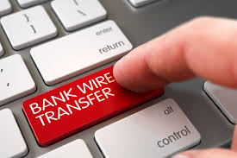
Demonstration Scenario
In the next demo, we will apply a detached digital signature with GPG.
This is the same GPG program used for GPG asymmetric encryption.
Let’s take a look!
Notes:
shutterstock_1888488028

Slide 67
Signing with GPG

Slide 68
Digital signatures
In this activity, you will continue to play the role of a security analyst working for the Hill Valley Police department.
Captain Strickland has sent you several more urgent messages about the Alphabet Bandit case.
It's quite likely that one of the messages was sent by the Alphabet Bandit pretending to be Captain Strickland to throw off the investigation.
Your task is to use GPG to determine which of the messages
is not authentic.
20 minutes

Slide 71
Applied Cryptography and Cryptographic Attacks

